Slide 1
Bradford on Avon Business Survey
Ian Nockolds
June 2023

Slide 2
Background
Pilot study for Cognisant
Economic outlook for local businesses:
Impact of:
The pandemic
Brexit
Cost of living crisis
Business environment:
Opportunities
Barriers to growth

Slide 3
Our Approach
Online survey run between 9 September 2022 and 3 February 2023 achieving 40 completed interviews.
Promoted via:
  BOA Business
  BoA TC Social Media
  Door to Door contact from BoA TC
All responses were anonymous

Slide 4
Respondents
Standard Industrial Classification | Overall | Sole trader | Micro (<10 employees) | Small (10-49)
Manufacturing | 3 | - | 3 | -
Construction | 1 | - | 1 | -
Wholesale and retail trade; repair of motor vehicles and motor cycles | 8 | 3 | 3 | 2
Accommodation and food service activities | 4 | - | 2 | 2
Information and communication | 7 | 2 | 2 | 3
Real estate activities | 1 | - | 1 | -
Professional, scientific and technical activities | 4 | - | 2 | 2
Education | 1 | 1 | - | -
Human health and social work activities | 1 | - | - | 1
Arts, entertainment and recreation | 3 | 1 | 2 | -
Other service activities | 7 | 3 | 4 | -

Slide 5
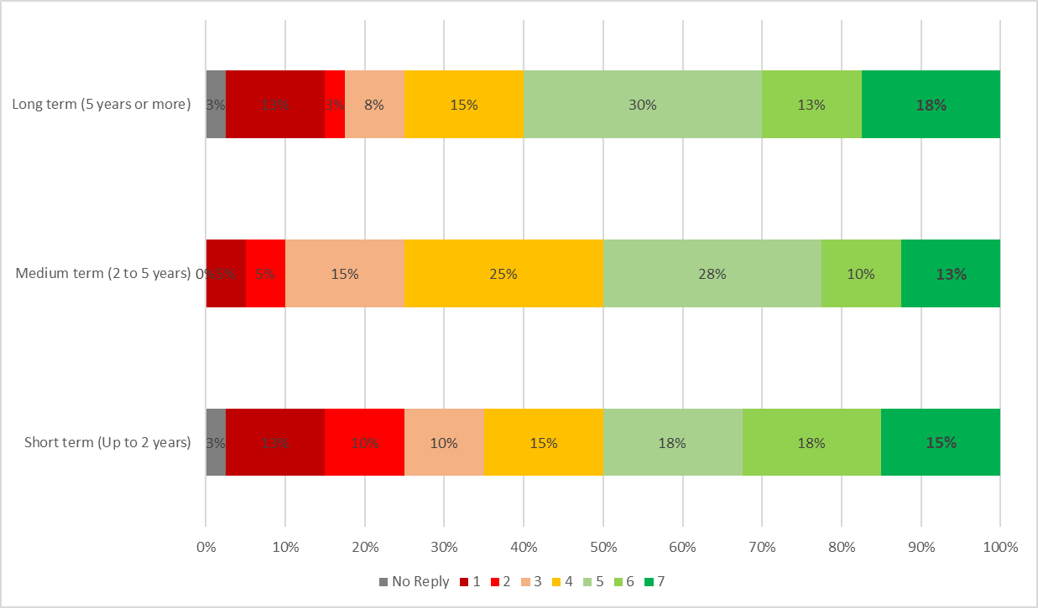
In terms of your businesses survival and growth, how confident are you about the short, medium and long term future of your business.
n = 40

Slide 6
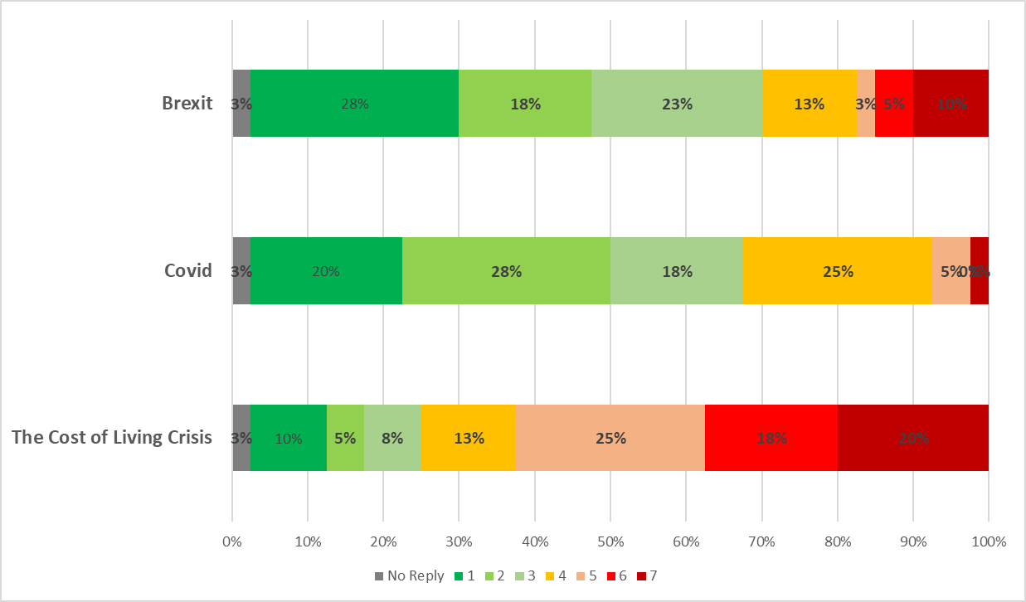
How much of a concern are the following three factors on the future of your business.
n = 40

Slide 7
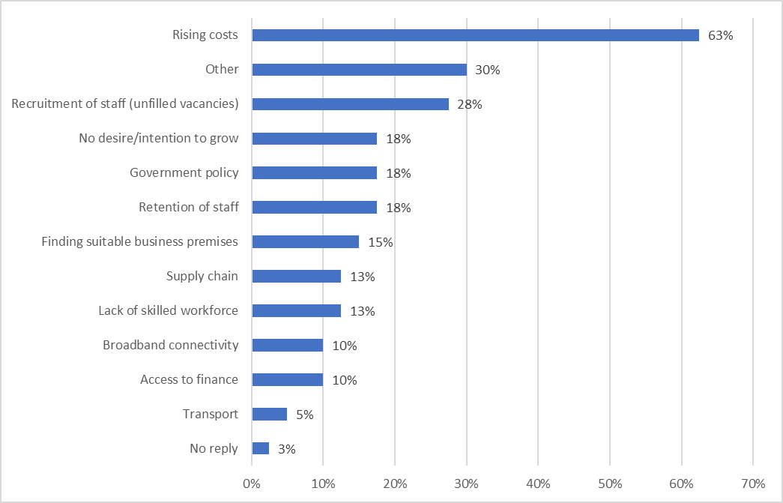
What are the main barriers limiting the growth of your business?
n = 40

Slide 8
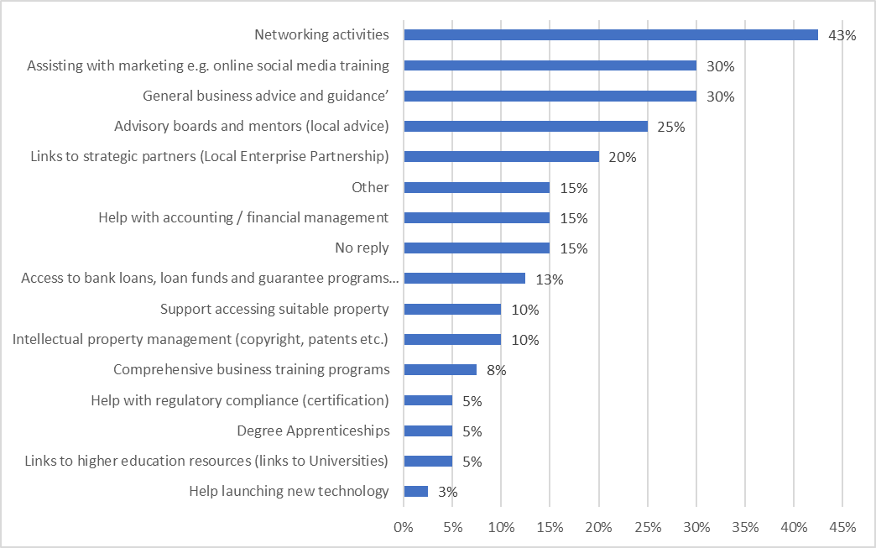
Which of these support services would you be interested in using if they were readily accessible to you:
n = 40

Slide 9
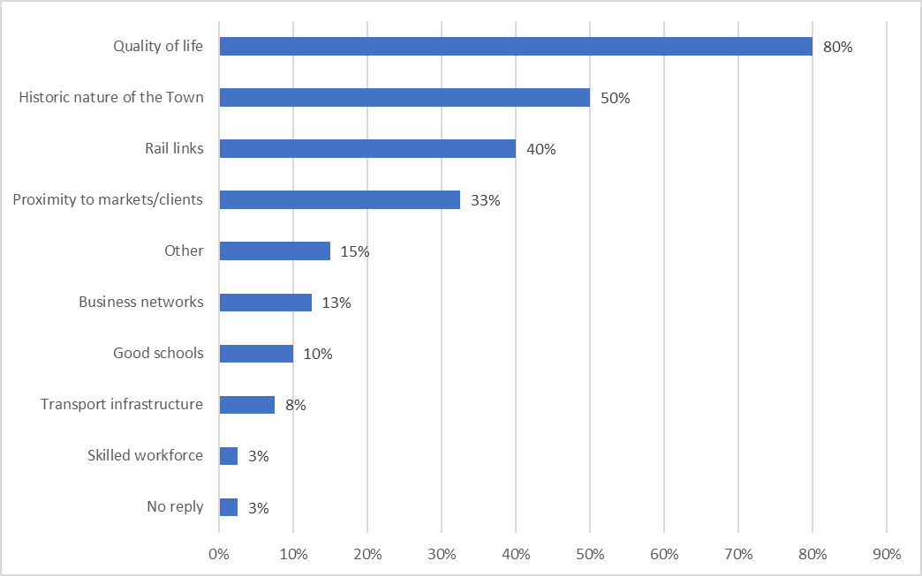
What, based on your knowledge and experience, are the main advantages of having your business located in Bradford on Avon?
n = 40

Slide 10
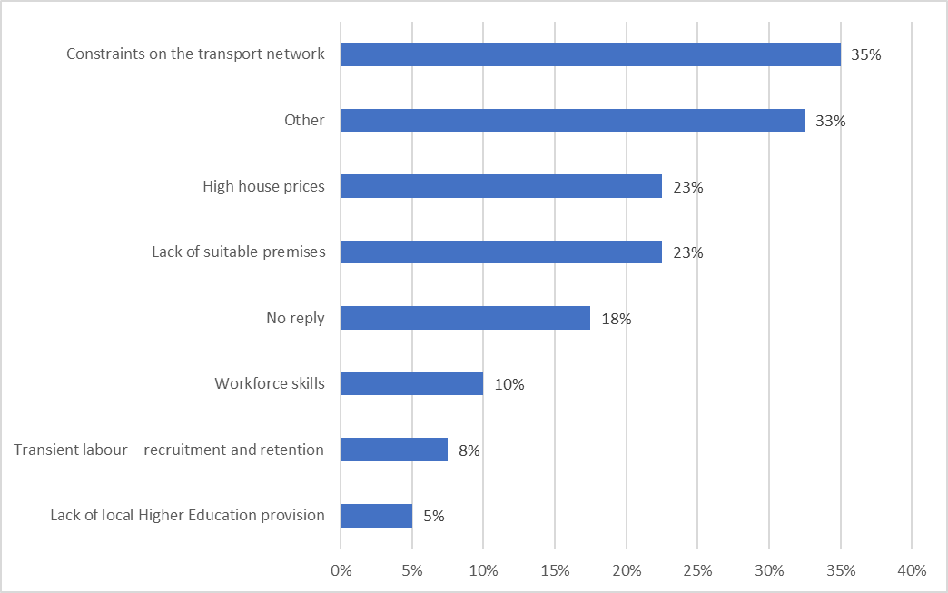
What, based on your knowledge and experience, are the main disadvantages of having your business located in Bradford on Avon?
n = 40

Slide 11
Conclusions:
Business with greatest concerns:
    Accommodation and Food
    Retail
    Turnover decline greatest amongst sole traders
Business confidence greatest in the longer term (5 years or more) at 60% compared to 50% in the short and medium term
Rising costs and recruitment the greatest barriers limiting growth
46% of businesses have returned to or exceeded pre-lockdown business turnover
    18% not confident they will return
    10% concerned about survival

Slide 12
Conclusions:
58% of businesses require no Brexit related support
The cost of living crisis is significantly more of a concern to businesses with 63% expressing concern compared to 18% for Brexit and 8% for Covid
Networking is the most popular support service at 43%
    Followed by marketings assistance at 30%
45% of respondents would ask friends and family for business support compared to 25% who would ask a business representative group
    43% would ask their accountant
    20% would ask Wiltshire Council
    18% would ask the Swindon and Wiltshire LEP

Slide 13
Conclusions:
Quality of Life main benefit of having a business in Bradford on Avon at 80%
    Followed by the historic nature of the town (50%) and rail links (40%)
Transport constraints biggest disadvantage of having a business in Bradford on Avon at 35%
    Followed by house prices and lack of suitable premises, both at 23%

Slide 14
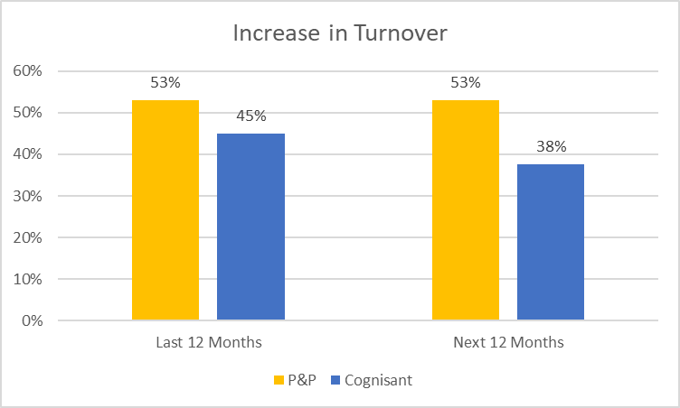
Comparison:
Turnover

Slide 15
Comparison:
Positives
  84% of town centre users rated physical appearance as a positive aspect of Bradford on Avon in 2017
    Cafes/restaurants; cafes/restaurants (83%) were classed as a positive aspect of the town by town centre users
  Quality of life was top scoring advantage of having a business located in Bradford on Avon in 2023
    Followed by historic nature of the town at 50%

Slide 16
Comparison:
Negatives
  Traffic congestion (90%) and air pollution (69%) were classed as the most negative aspects of Bradford on Avon by town centre users in 2017
    A number of town centre users highlighted the need to ‘Improve the retail offer’ in Bradford on Avon
  Constraints on the transport network was the main (35%) disadvantage of having a business located in Bradford on Avon in 2023
    Congestion was identified in the other comments
    High house prices and the lack of suitable premises were equally identified by 23% of respondents

Slide 17
Next Steps:
Understanding the problems
  Mentoring & support
  Events
  Business Forum
Talking up local business

